Slide 1
Wireframe For Visualization
- Vishal Kumar

Slide 2
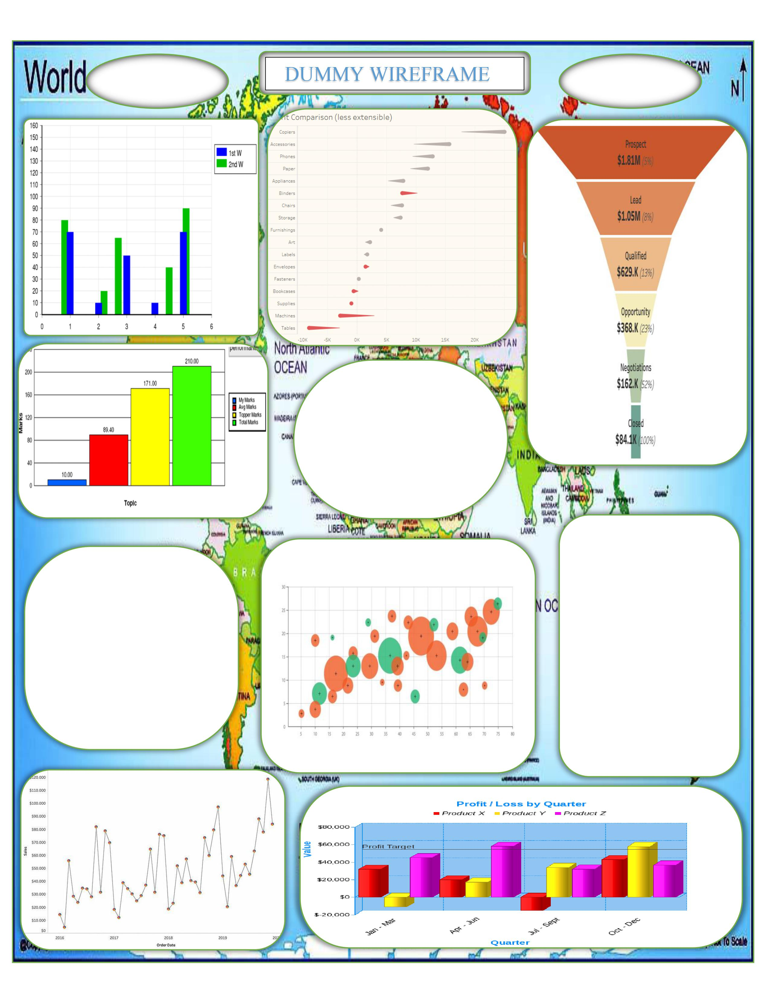
Dummy Wireframe

Slide 3
BUDGET ESTIMATION

Slide 4
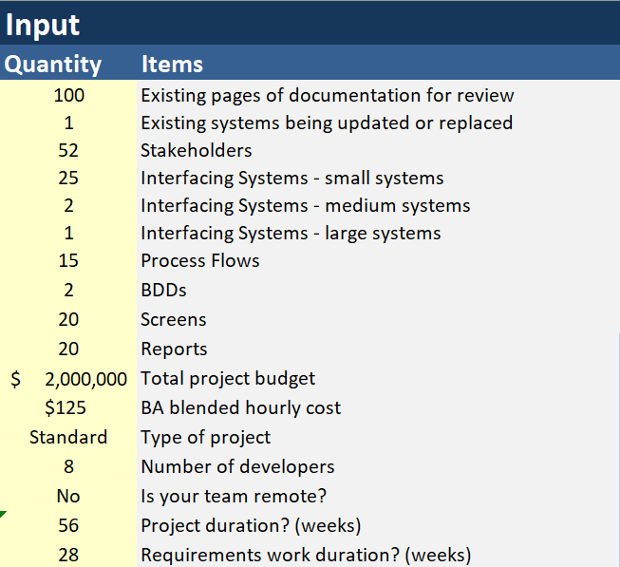

Slide 5
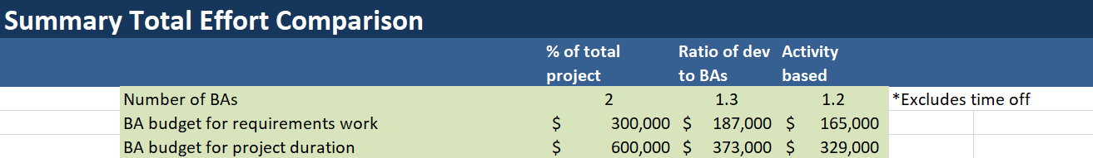
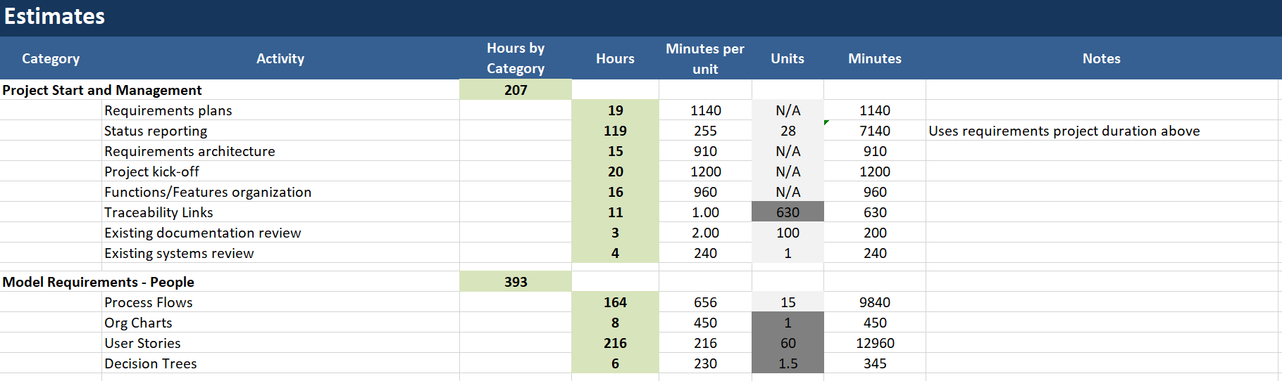
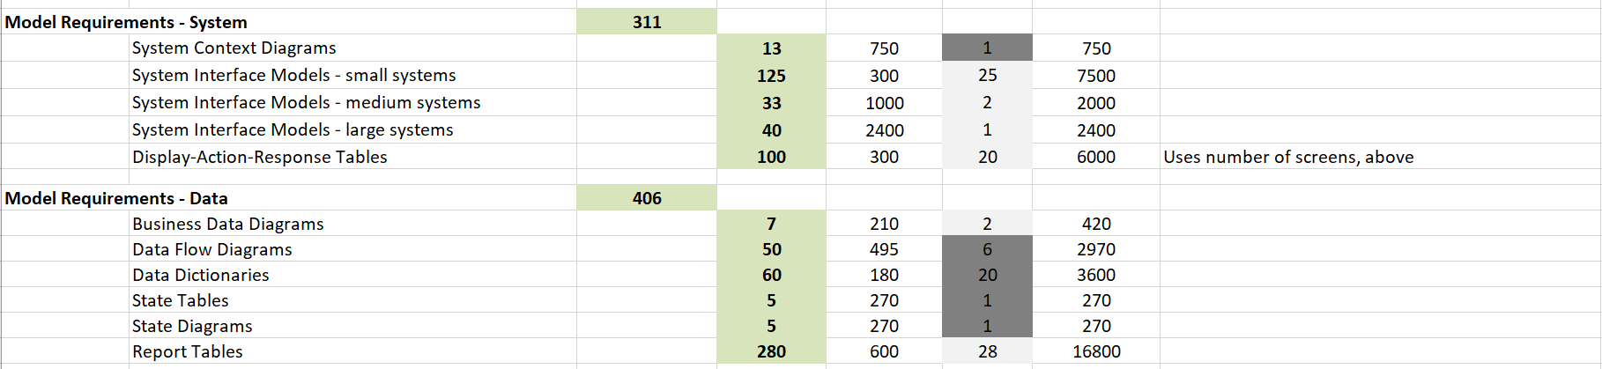

Slide 6
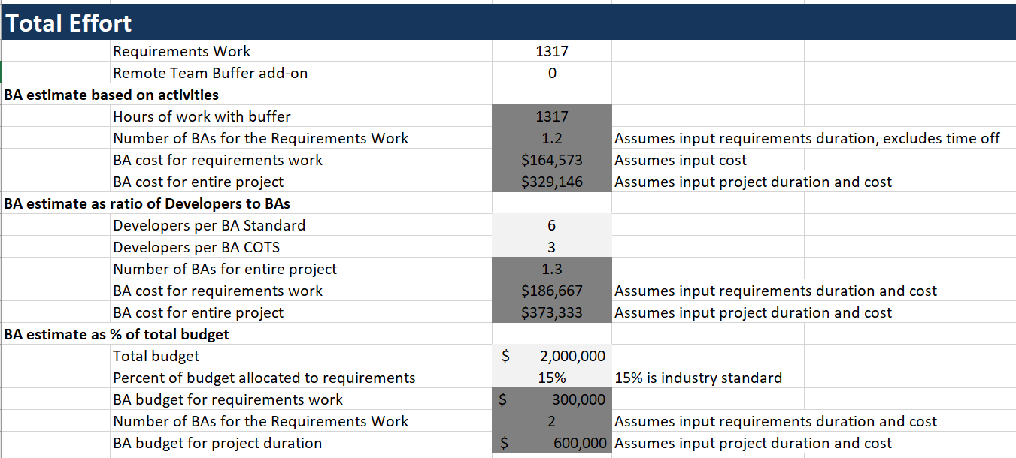

Slide 7
Thank you

